Slide 1

FLUTTER
(WEB / ANDROID / IOS / MAC / WINDOWS)
Software Development Master Course

Slide 2
INTRODUCTION OT FLUTTER:
Outlines:
What means flutter?
Why we need flutter?
Features of flutter
Flutter VS React

Slide 3
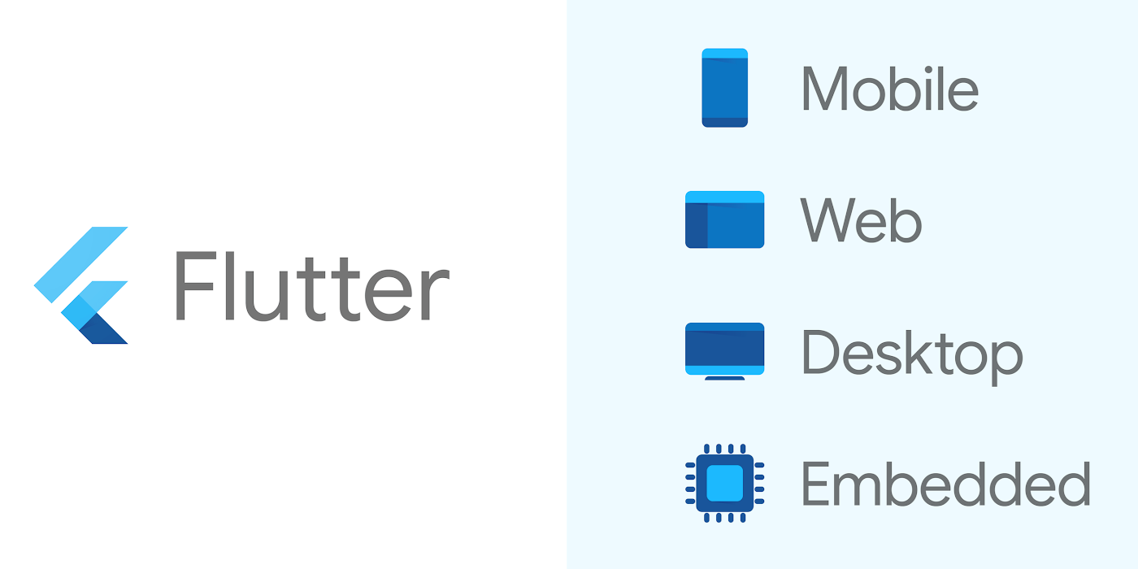
FLUTTER?​
Flutter is an open-source UI framework developed by Google and it is native cross-platform( Android, iOS, windows, web)​
It is one programming language and codebase.​
Flutter uses Dart Language.​

Slide 4
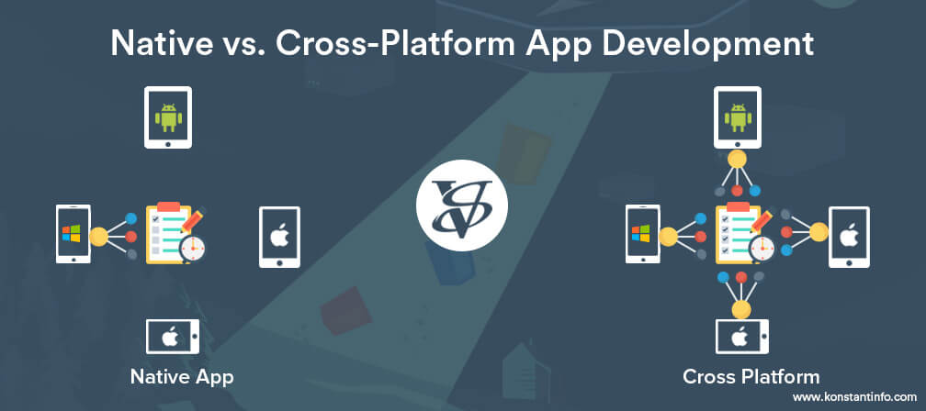

Slide 5
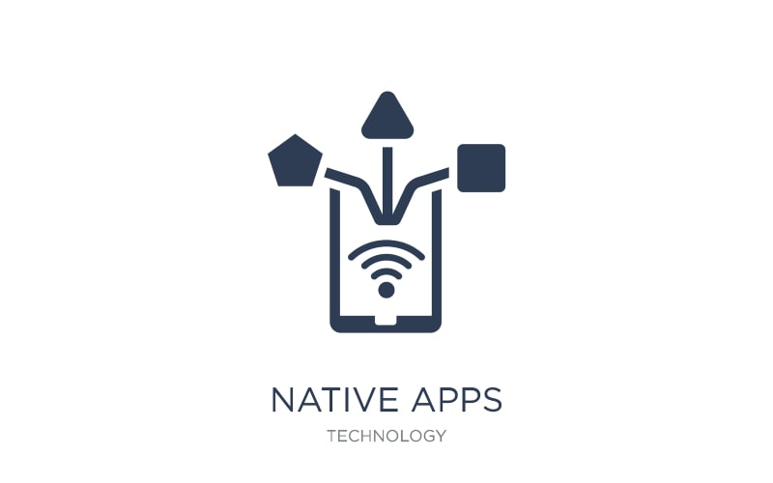
- An application developed exclusively for a single platform using a native-to-the-operating-system language is a Native app .​​ - Example: you can develop a native Android app with Java or Kotlin and choose Swift and Objective-C for iOS apps.​
NATIVE APP DEVELOPMENT

Slide 6
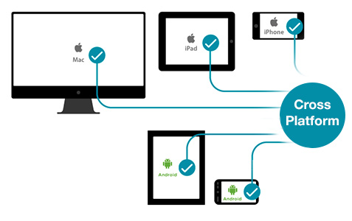
Cross-platform is also known as multiplatform or platform independent.​ "Write code once and reuse for different platform".
CROSS APP DEVELOPMENT

Slide 7
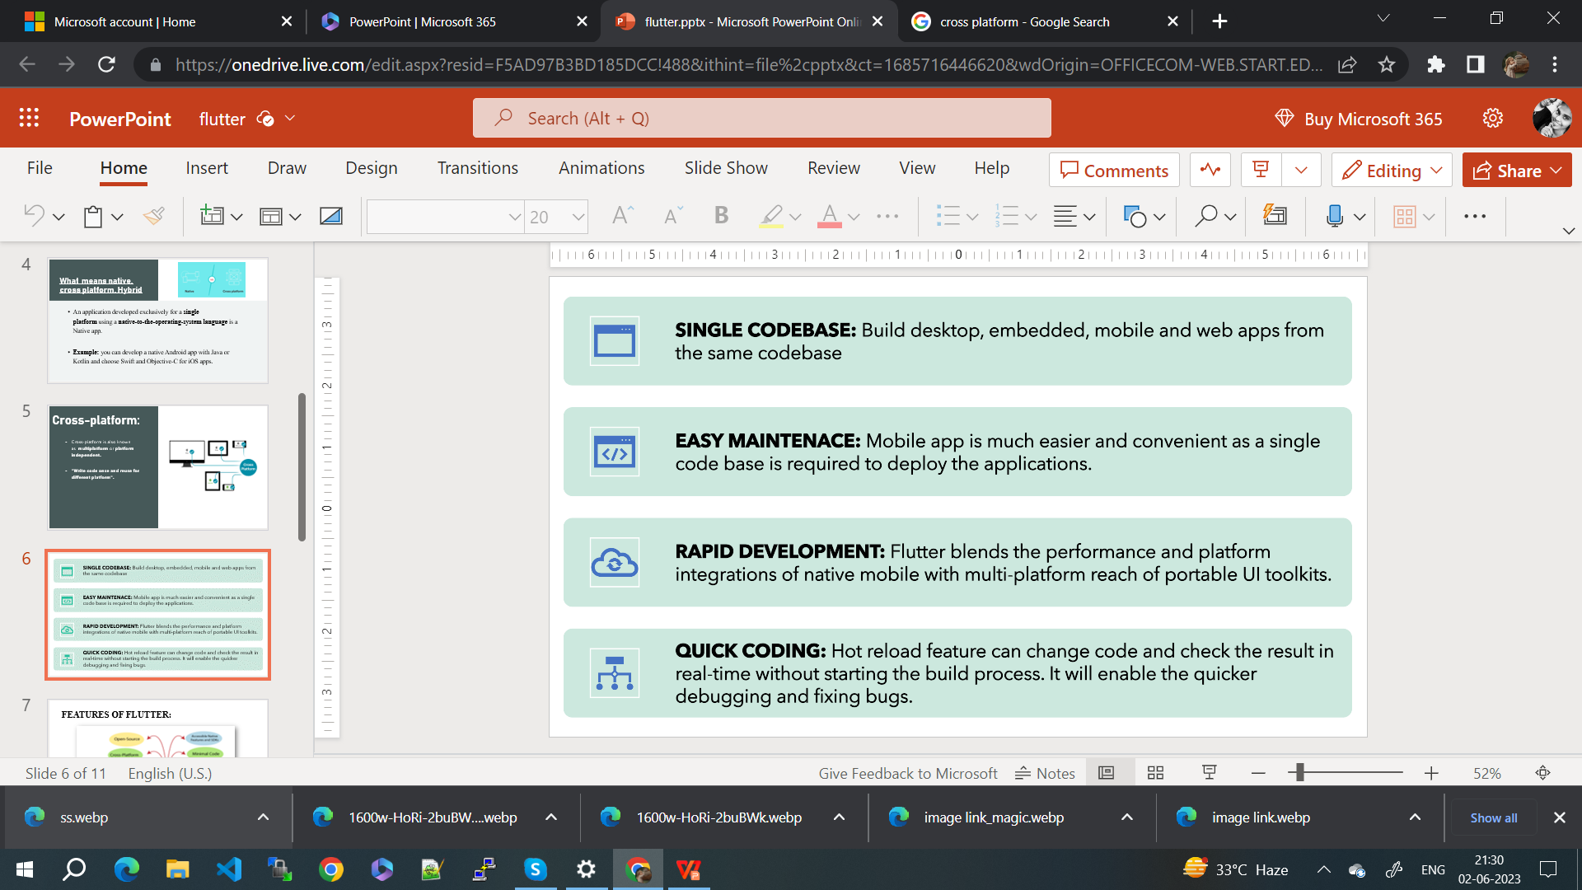
FEATURES OF FLUTTER:

Slide 8
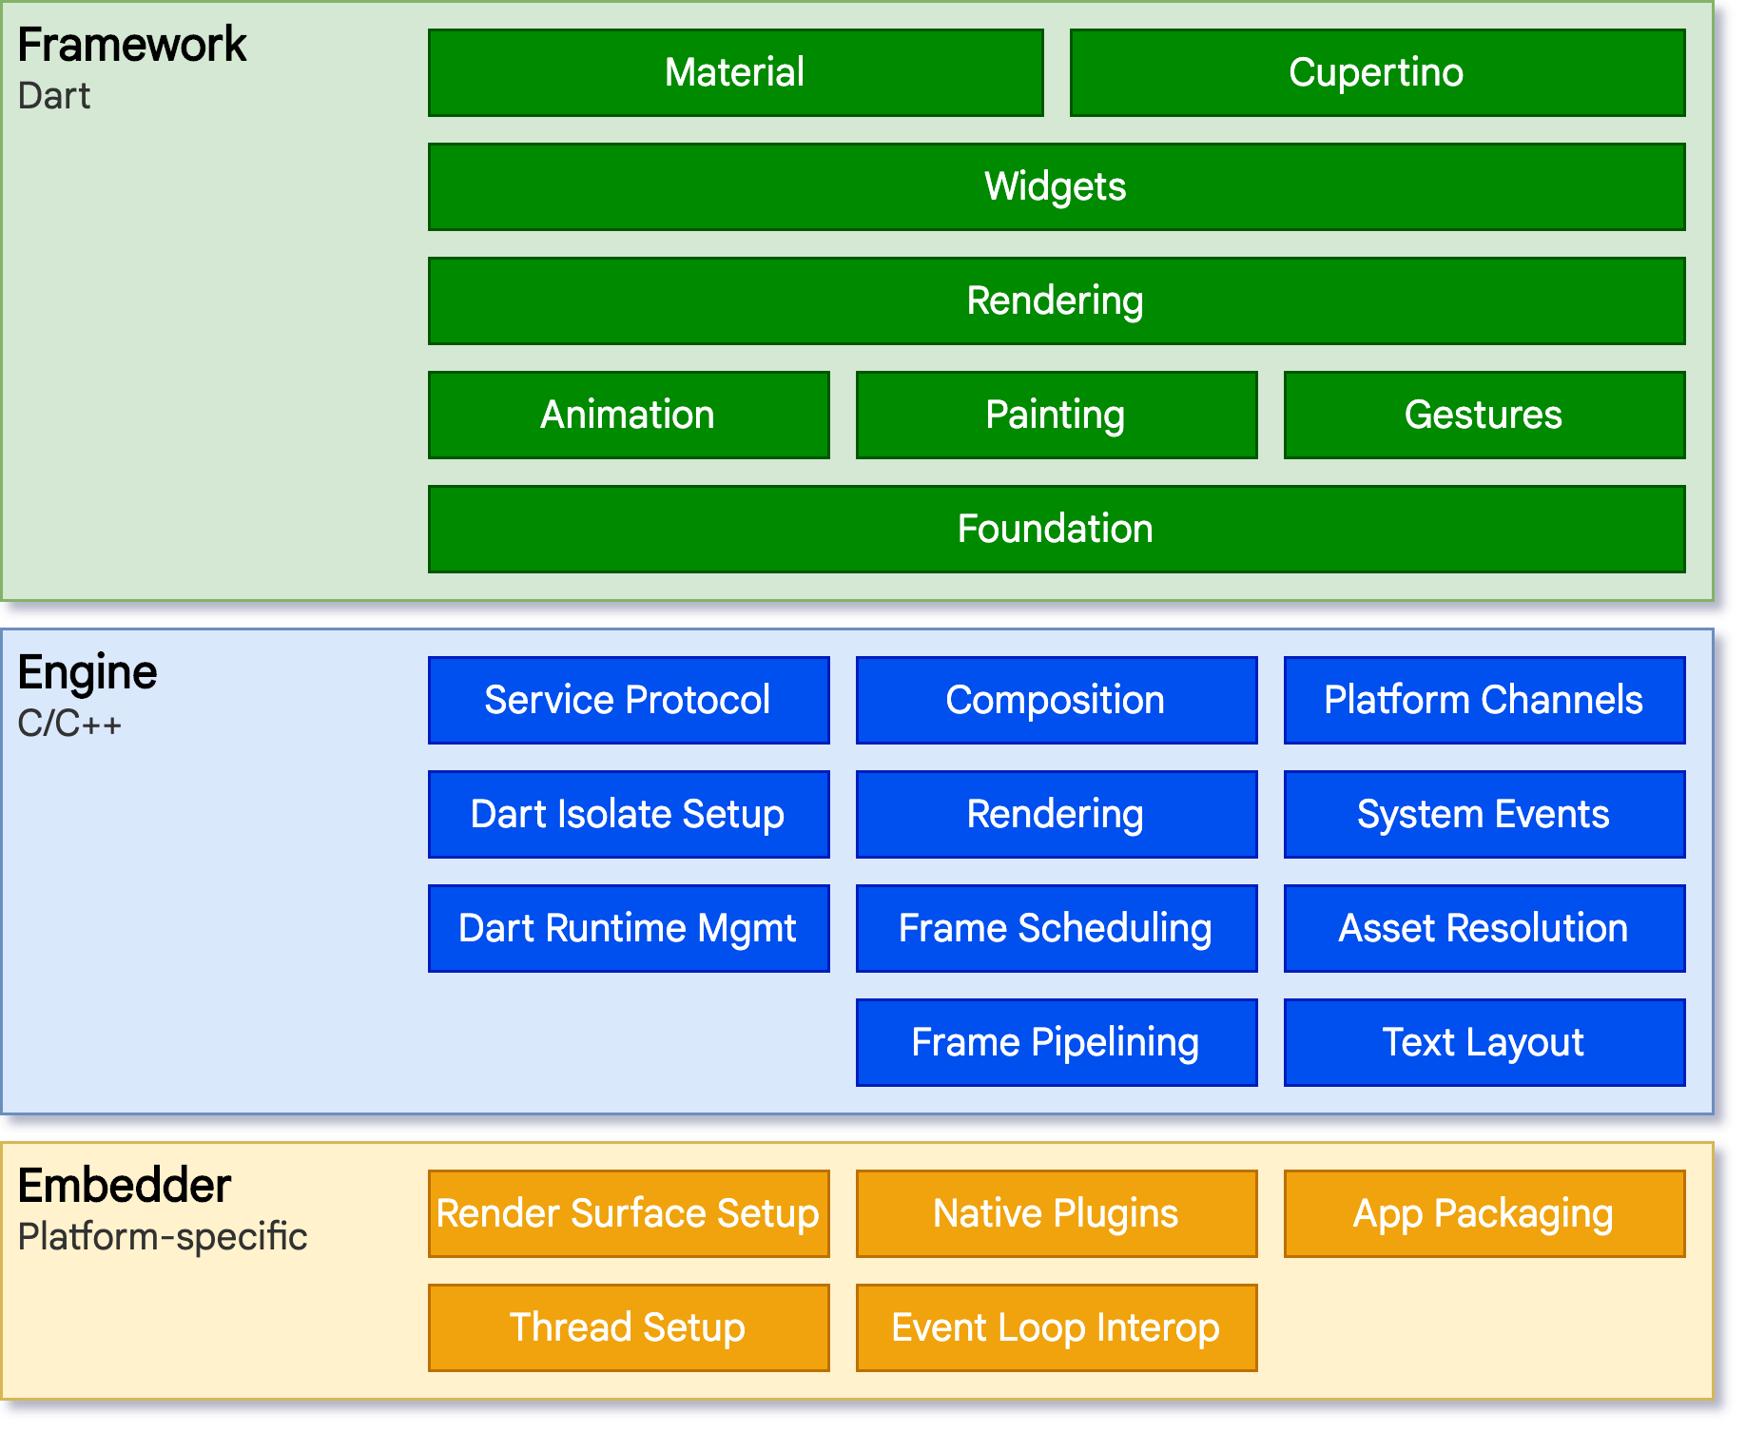
FLUTTER ARCHITECTURE:

Slide 9
1)Flutter Engine​ 2)Foundation Library. 3)Widgets. 4)Design Specific Widgets
Flutter Engine
It is a portable runtime for high-quality mobile apps and primarily based on the C++ language.​
It implements Flutter core libraries that include animation and graphics, file and network I/O, plugin architecture, accessibility support, and a dart runtime for developing, compiling, and running Flutter applications.​

Slide 10
-It contains all the required packages for the basic building blocks of writing a Flutter application. ​ -These libraries are written in Dart language.​
Foundation Library​
Widgets
-Widget is a piece of code that represents a visual component or an interactive element in a user interface.​
-Widgets are responsible for defining the structure, appearance, and behavior of the user interface elements.

Slide 11
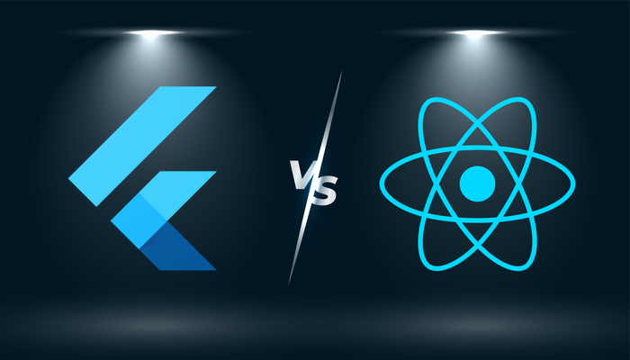

Slide 12
